Slide 1
Heat Smart Orkney
Demand response valuation exercise

Slide 2
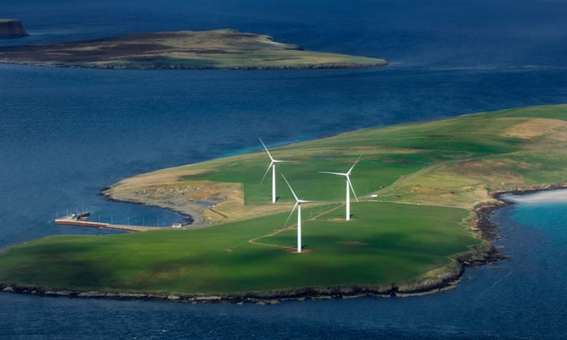
Introduction: Orkney Paradox (1)
Orkney Isles are an archipelago off the North tip of Scotland.
Great potential for renewable energy (RE) generation, in particular wind and tidal energy.
Home to almost 50MW wind generation capacity¹:
Over 500 domestic turbines
5 large (0.9MW) community-owned turbines
41 MW capacity of other commercial wind generation
Renewable power generation reached 120% of the local electricity consumption by 2013 and the islands became a net power exporter.

Slide 3
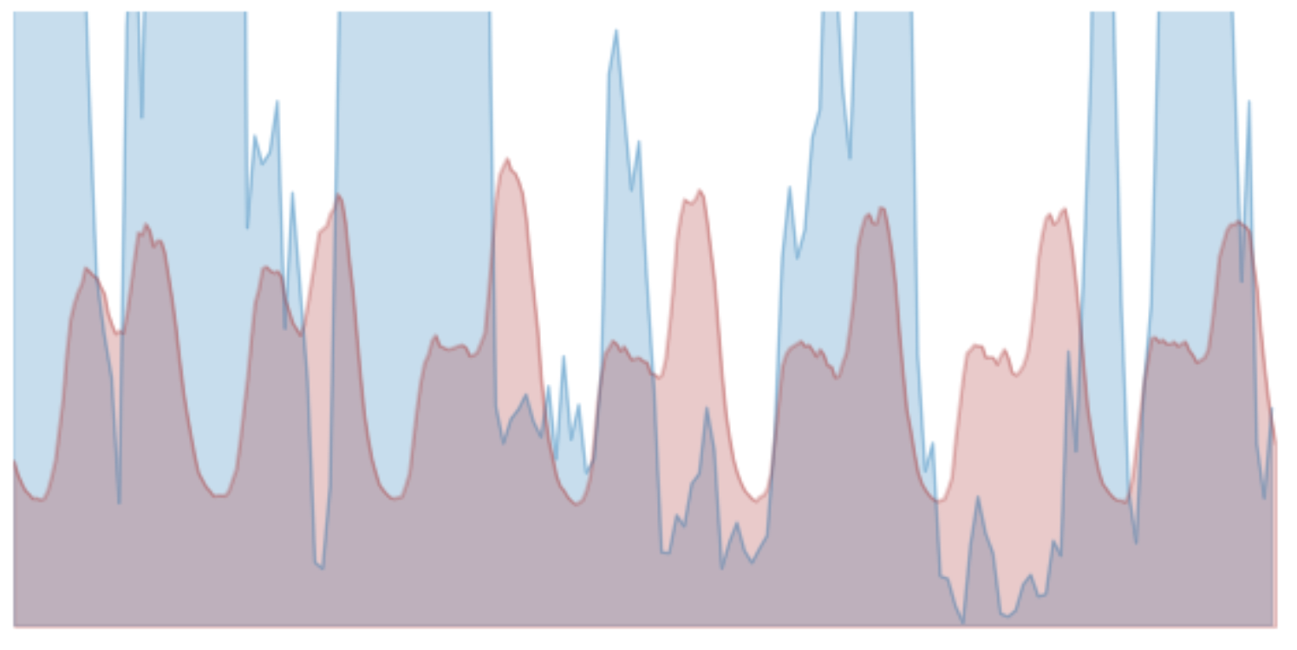
Introduction: Orkney Paradox (1)
However, there is a mismatch between demand and supply of energy, due to intermittence of RE generation, and limited export capacity.
RE generation consistently suffers from curtailment.
Since 2012, a moratorium³ is in place on new connections of RE generation to the power grid.
The isles continue to rely on electricity imports and use large volumes of hydrocarbons².
One of the highest levels of CO2 emissions per capita in the UK.
One of the highest levels of energy poverty in the UK.
Excess generation: exported or curtailed
Low generation has to be compensated by imports

Slide 4

Task and Objectives
Is there a commercially viable opportunity to reduce wind energy generation curtailment and improve well-being of the residents?
OBJECTIVES:
Calculate current impact of curtailment
Quantify potential benefits of introducing electric storage heaters to Orkney households
Estimate the impact of Demand Response at various levels of household participation
Highlight further opportunities

Slide 5
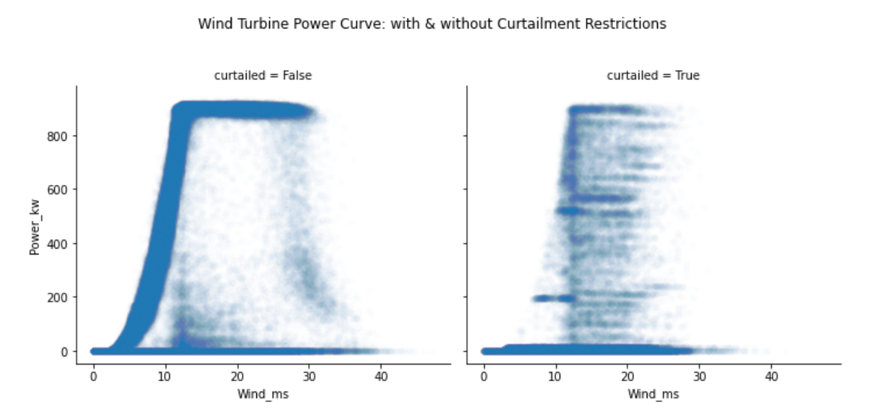
Some definitions
A wind turbine is in curtailment when its power output is restricted by the grid operator and is below its expected output under given wind conditions.
We measure the lost energy during a curtailment event by comparing the actual power output with the estimated power output that should have been achieved given the actual wind speed.
kWh is our measure of energy. To be precise: it is the amount of energy required to keep a 1 kW appliance running for an hour.
below expected output

Slide 6
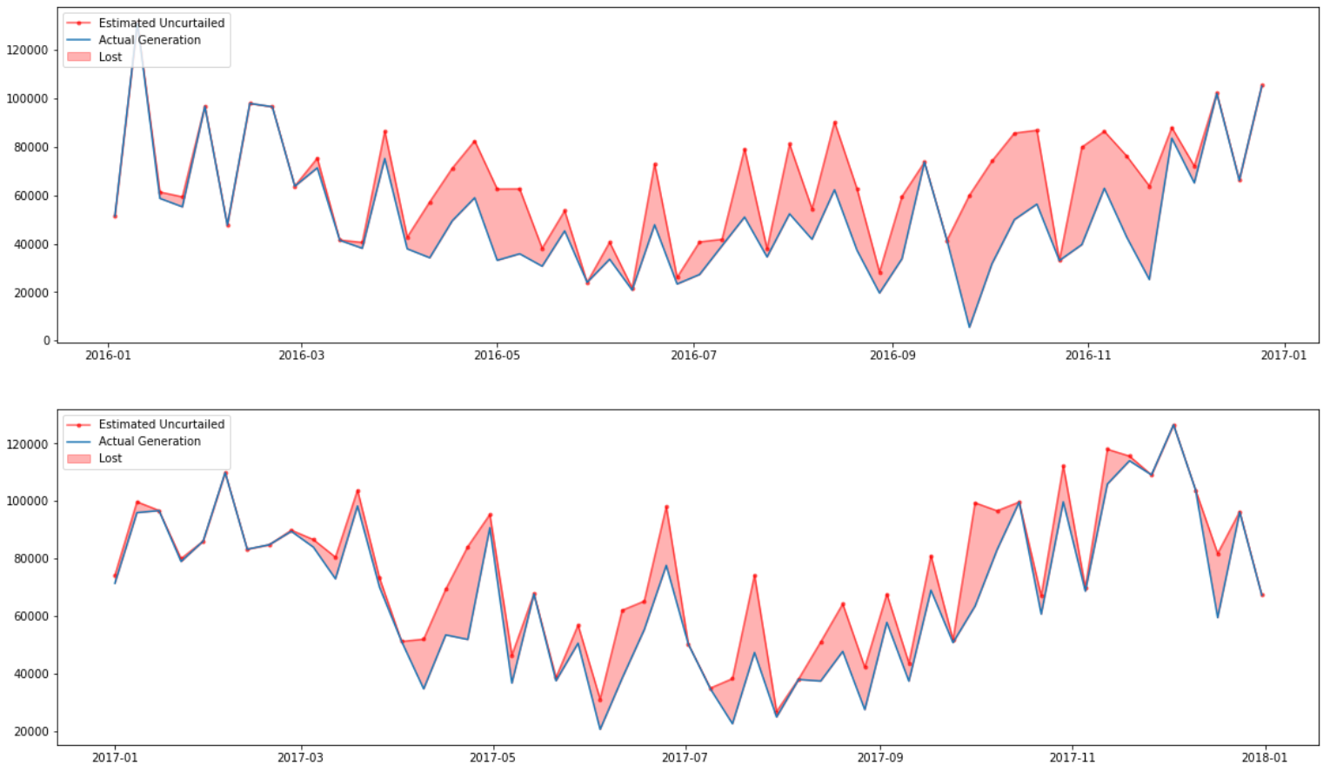
1. Current impact of curtailment – Sample turbine
Total energy lost due to curtailment in 2016 was 700 MWh's, and 400 MWh's in 2017.
Actual generation vs estimated potential, weekly averages (kWh)
In warm months there are periods when neither the local nor the mainland UK demand is sufficient to absorb Orkney wind energy --> curtailment.
In winter, where the demand is the highest, the energy loss is at its lowest.

Slide 7

1. Current impact of curtailment – Overall Orkney
Assuming that all wind generation on Orkney Isles falls under the same curtailment profile, we get to an annual loss of 20.5 GWh, even if we base it on the relatively lower number of 2017 curtailment.
→ The curtailed energy could provide sufficient power for 5,232 UK households⁴.
5,232 UK Households

Slide 8
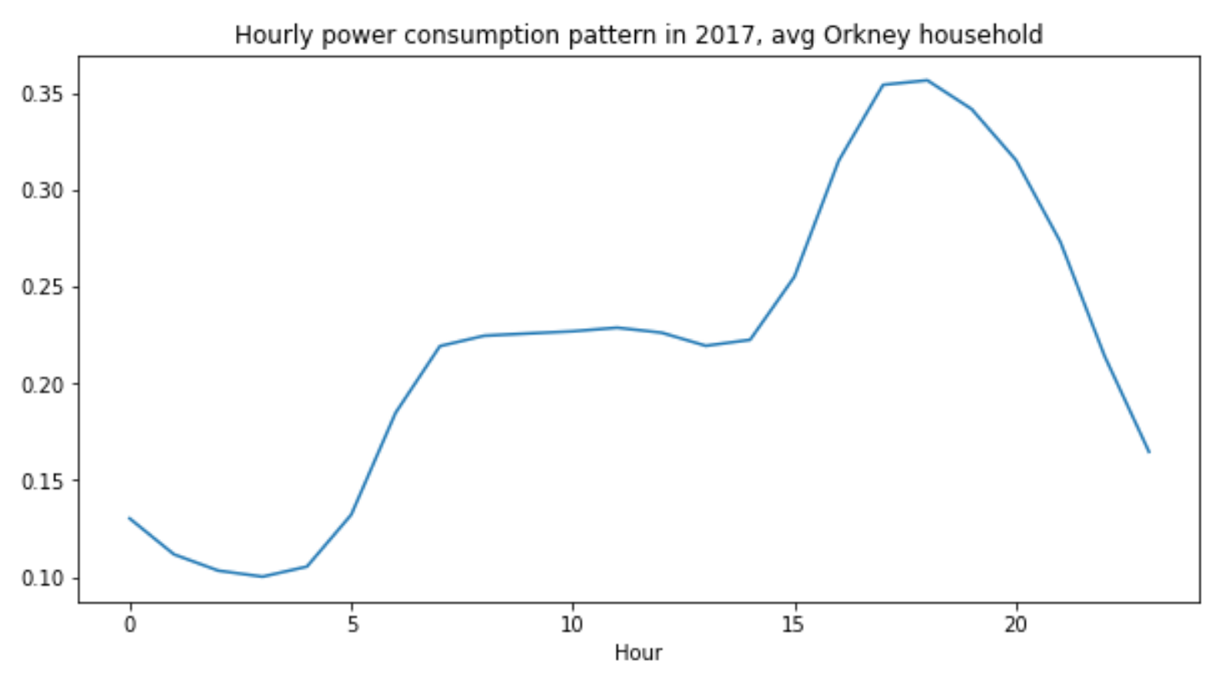
2. Reshaping demand with electric storage heaters
43% of the population (~4,500 households) of the Orkney isles uses electricity for heating.
For those who do, 75% of the consumed electricity relates to space heating.
OPPORTUNITY: If modern storage heaters are introduced to Orkney households, a large share of consumption can be shifted within a day.
ADVANTAGES:
Practical and a simple way to smoothen demand profile;
Potential to reduce curtailment;
Consumers can take advantage of lower ‘off peak’ pricing

Slide 9
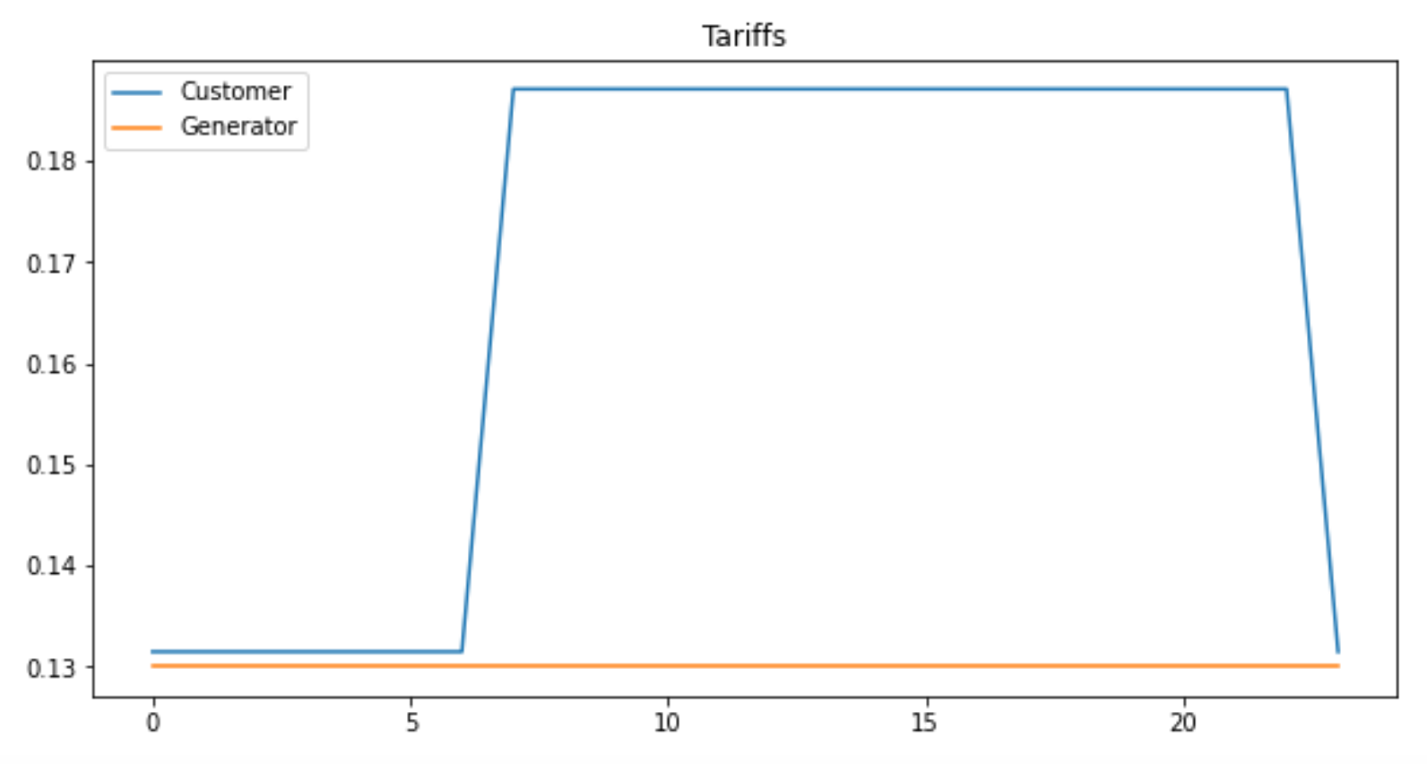
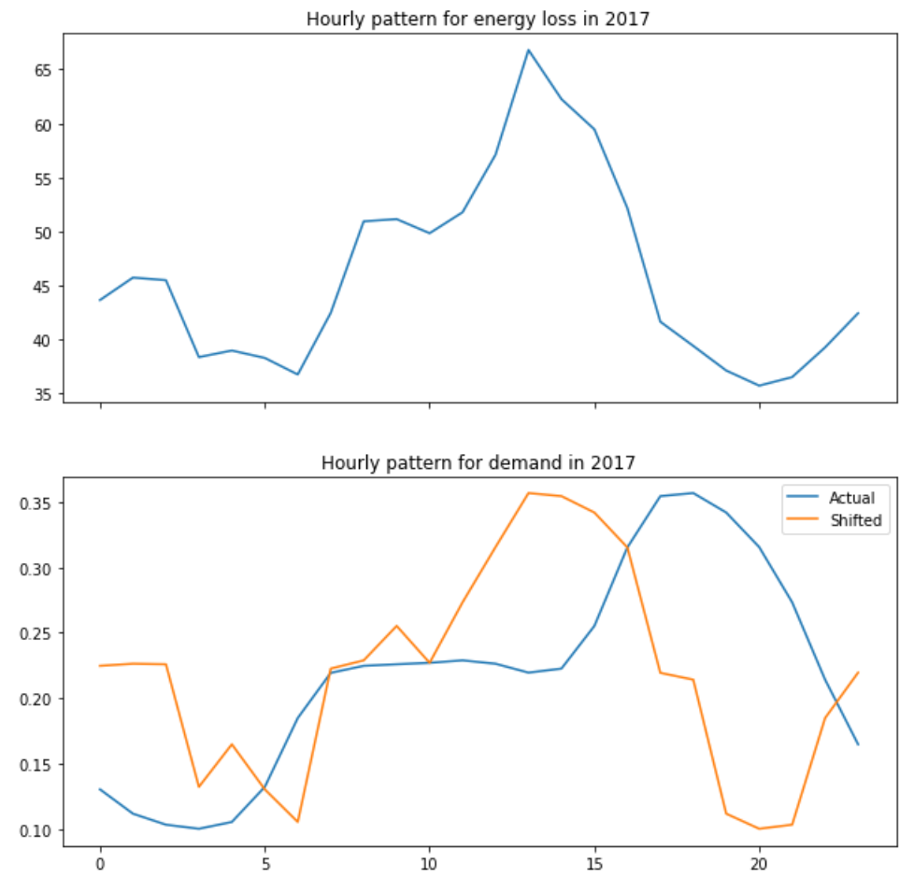
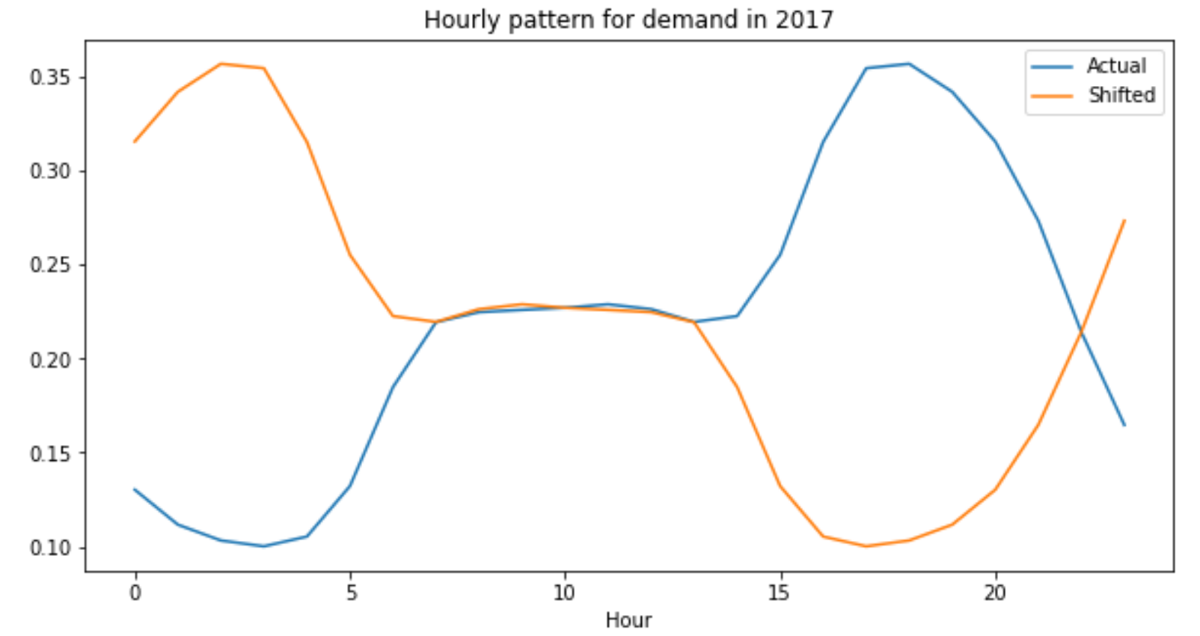
2. Reshaping demand with electric storage heaters
Scenario 1 – Focus on price
Scenario 2 – Focus on curtailment
E7 ‘Day’ tariff
Focus
E7 ‘Night’ tariff
Shift peak to benefit from low pricing
Shift to match curtailment

Slide 10
2. Reshaping demand with electric storage heaters
Our proposed model calculates reductions in curtailed energy at different levels of DR penetration, considering a shift in the demand pattern.
We tested various DR penetration levels, with energy ‘saved’ from curtailment ranging from 0.3 GWh with 25% DR to 1.9 GWh with 100% DR.
Similarly, we tested various levels of discount offered by generators. If 50% DR penetration is assumed, then customers would see reduction in their annual energy cost by 5%, 6%, 12% and 16% under 0%, 25%, 50% and 75% discount levels respectively.

Slide 11

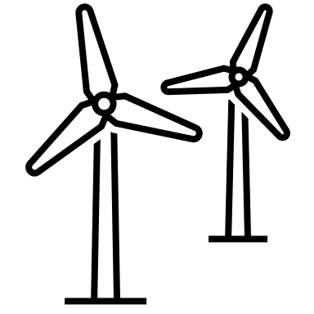
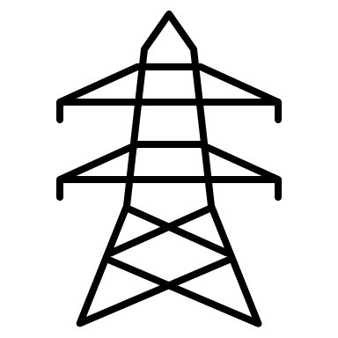



2. Storage heaters as a tool to shift demand – Who wins?
 | Residents | Immediate reduction to utility bills, more control over consumption
 | RE Generators | Lower curtailment losses → improved project returns
 | Grid Operator | Reduction in demand fluctuation → lower pressure for scale and schedule of capital-intensive system capacity upgrades
 | Communities | Increased revenues from cummunity turbines, reduction in fuel poverty
 | Government | Targeted assistance in line with the federal and regional energy priorities, ability to monitor performance and efficacy of funding
The default case assumes that the cost of the hardware (storage heaters and smart units) will be covered by a government grant. However, we incorporated a flexibility to vary the split of cost burden between consumers and the local generators, participating in the programme.

Slide 12
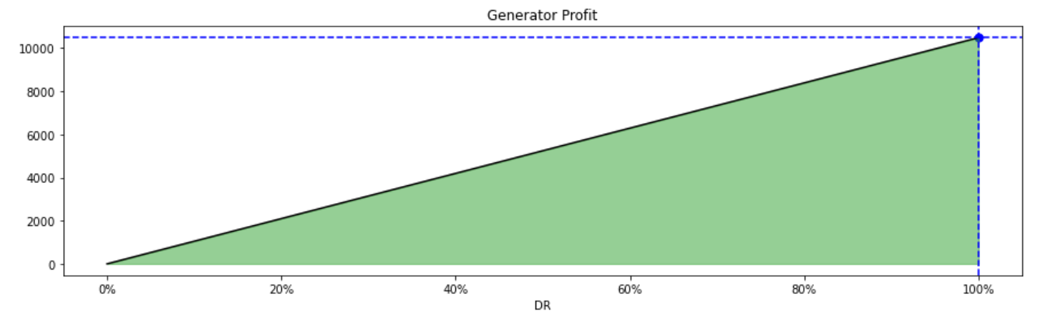
3. Impact of Demand Response at various levels of household participation
Generator:
The more customers sign up for the DR scheme, the more savings
Effect of shifting demand to off-peak hours: potential savings of £145,911.50/year
The generators can offer a discount on electricity saved from curtailment up to 29.625% to break even.
Consumer:
Effect of shifting demand to off-peak hours: potential savings of £21/year (or 5% of their default cost).
With a 29.625% discount offered on the electricity saved from curtailment, the savings would increase to £38/year (9%)

Slide 13
Recommendations
Based on the data analysis and the modelling we performed for this exercise we can conclude that there is high potential to:
reduce curtailment of wind generation in Orkney
reduce electricity costs for the islands' residents, and as the result - reduce fuel poverty levels
Having said so, we can see that the cost of upgrading to modern storage heaters can be seen as prohibitive to a large share of the population, especially considering the relatively low level of income on the islands.
We believe that the policy makers and utilities need to be involved in designing the best solution. Ideally, that would involve government funding for upgrade of residential heating.

Slide 14
4. Further Opportunities
Currently 39% of Orkney households relying on hydrocarbons (oil and coal) for heating:
conversion from oil and coal boilers to electric heating would
increase Orkney electricity consumption by up to 10.2 GWh a year and
cut the islands’ CO2 emissions by up to 4.6k tons a year.
additional local demand can unlock new RE projects on the islands.
Introduce hydrogen or battery-based energy storage into the mix of the system balancing tool.
→ would allow not only to shift the consumption, but potentially take advantage of tariff arbitrage opportunities.

Slide 15
Thank You

Slide 16
References
Danish Wind Industry Association, 2003. Annual Energy Output from a Wind Turbine. Available at: http://drømstørre.dk/wp-content/wind/miller/windpower%20web/en/tour/wres/annu.htm
Orkney Islands Climate History. Available at: https://www.myweather2.com/City-Town/United-Kingdom/Orkney-and-Shetland/Orkney-Islands/climate-profile.aspx?month=12
National records of Scotland. Available at: http://www.nrscotland.gov.uk/
Scottish Energy Statistics Hub, 2018. End use of energy consumption. Available at: https://scotland.shinyapps.io/sg-scottish-energy-statistics/?Section=EnergyEfficiency&Subsection=DemandReduction&Chart=HHoldEnConsumption
Oliphant, T.E., 2006. A guide to NumPy, Trelgol Publishing USA.
McKinney, W. & others, 2010. Data structures for statistical computing in python. In Proceedings of the 9th Python in Science Conference. pp. 51–56.
Hunter, J.D., 2007. Matplotlib: A 2D graphics environment. Computing in science & engineering, 9(3), pp.90–95.
Waskom, M. et al., 2017. mwaskom/seaborn: v0.8.1 (September 2017), Zenodo. Available at: https://doi.org/10.5281/zenodo.883859.

